Slide 1
Electrostatics And Capacitance (1st Rank)
Prepared By- Guided By-
JAYDEEPSINH DABHI (131090109013) Mr. Mayank C Valani
KAJAL HIRAPARA (131090109014)
KAJAL SONDARVA (131090109015)
KANTESARIYA KARAN (131090109016)
KARENA HEMANT (131090109017)
KARMUR MAYUR (131090109018)

Slide 2
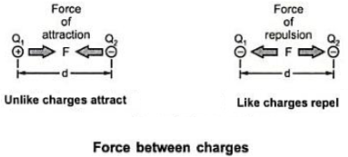
Electrostatics
Introduction
Concept of Electric charge
Laws of Electric Charges
Like charges repel - Unlike charges attract
Coulomb’s inverse Square Law.

Slide 3
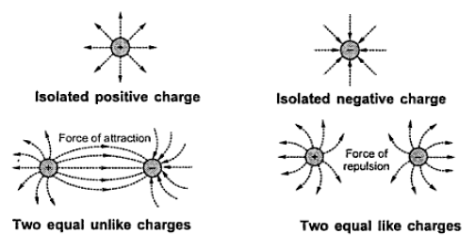
Electrostatic Field
Definition
Electric lines of force
Properties of Electric lines of force

Slide 4
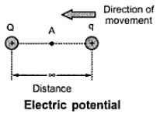
Electric Flux
Electric potential & Electric difference
Energy stored mgh
Same as per Fig.
Thus

Slide 5
Potential difference

Slide 6
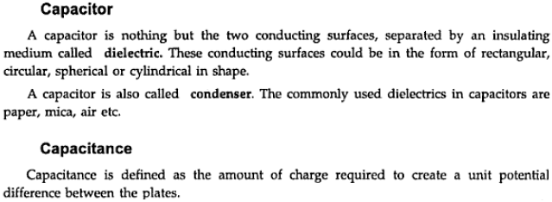
The properties of a capacitor to store electric energy in form of static charge is called capacitance.

Slide 7
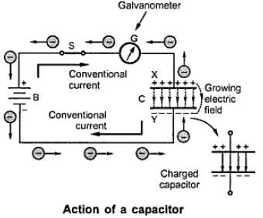
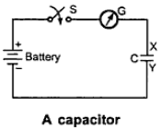
Action of a capacitor
Consider fig.
Relation between charge and applied voltage

Slide 8
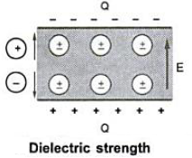
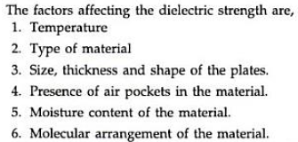
Dielectric strength

Slide 9
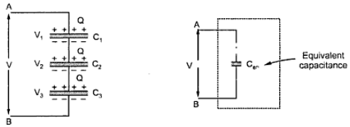
Capacitors in series

Slide 10
Capacitors in parallel

Slide 11
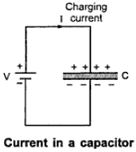
Energy stored in capacitor
Current in capacitor

Slide 12
Types of capacitor
Air
Paper
Mica
Poly carbonate
Electrolytic

Slide 13
Thank You!!!!

